Slide 1
Randomized Algorithms CS648
Lecture 14
Applications of Chebyshev’s Inequality
Random walk and electric networks

Slide 2
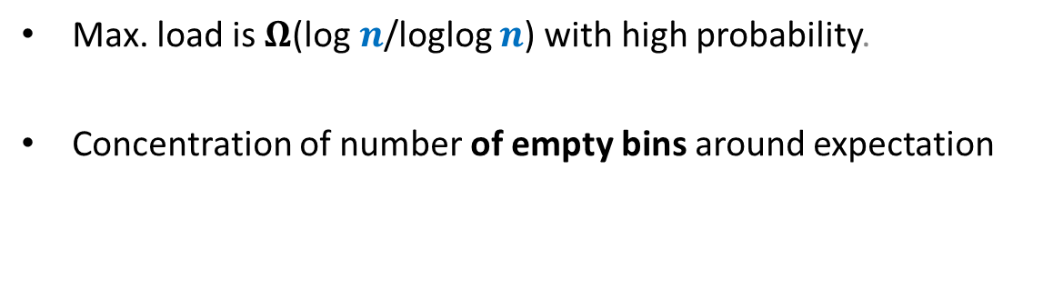
Chebyshev’s Inequality
Max. load is $Ω$(log $n$/loglog $n$) with high probability.
Concentration of number of empty bins around expectation

Slide 3
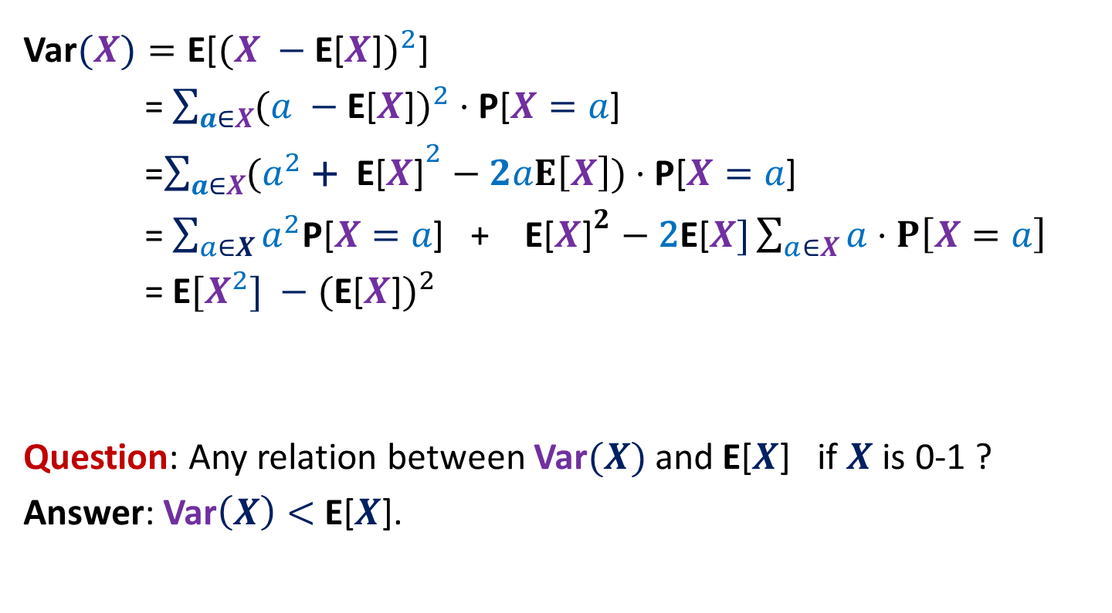

Variance of $X$
Var$(X)=\text{E}\text{[}{(X −\text{E}\text{[}X\text{]})}^{2}\text{]}$
= $\sum_{a∈X}{({a −\text{E}\text{[}X\text{]})}^{2}}⋅\text{P}\text{[}X=a\text{]}$
=$\sum_{a∈X}{({a^{2} \text{+ }\text{E}\text{[}X\text{]}}^{2}−2aE\left[X\right])}⋅\text{P}\text{[}X=a\text{]}$
= $\sum_{a∈X}{a^{2}\text{P}\text{[}X=a\text{]}\text{ + }\text{E}\text{[}X{\text{]}}^{2}−\text{2}\text{E}\text{[}X]\sum_{a∈X}{a⋅P\left[X=a\right]}}$
= $\text{E}[{X^{2}] −\text{(}\text{E}\text{[}X\text{]})}^{2}$
Question: Any relation between Var$(X)$ and $\text{E}\text{[}X$] if $X$ is 0-1 ?
Answer: Var$\left(X\right)<$ $\text{E}\text{[}X$].

Slide 4

Chebyshev’s Inequality
P[$|X−$E[$X$]| $>δ$]
= P[${\left(X −\text{E}\text{[}X\text{]}\right)}^{2}≥δ^{2}$ ]
Using Markov Inequality,
$$≤\frac{\text{E}\text{[}{(X −\text{E}\text{[}X\text{]})}^{2}\text{] }}{δ^{2}}$$
$$=\frac{\text{E}{[X^{2}] −\text{(}\text{E}\text{[}X\text{]})}^{2}\text{] }}{δ^{2}}$$
$$=\frac{\text{Var}\text{(}X\text{)} }{δ^{2}}$$
$$=\frac{(σ\text{(}X{\text{)}\text{)}}^{2} }{δ^{2}}$$
$σ$: standard deviation of $X$.

Slide 5


Covariance
Let probability space ($Ω$,P) be such that
$X ,Y$: any two random variables
Definition: Covariance($X,Y$) = $\text{E}\text{[}XY] −\text{E}\text{[}X\text{]}⋅\text{E}\text{[}\text{Y}\text{]}$
This is a quantitative measure for the dependency between $X$ and $Y$.
Observation:
If $X ,Y$ are independent ➔ ?
Think over it for a few moments …
Covariance($X,Y$) = 0

Slide 6
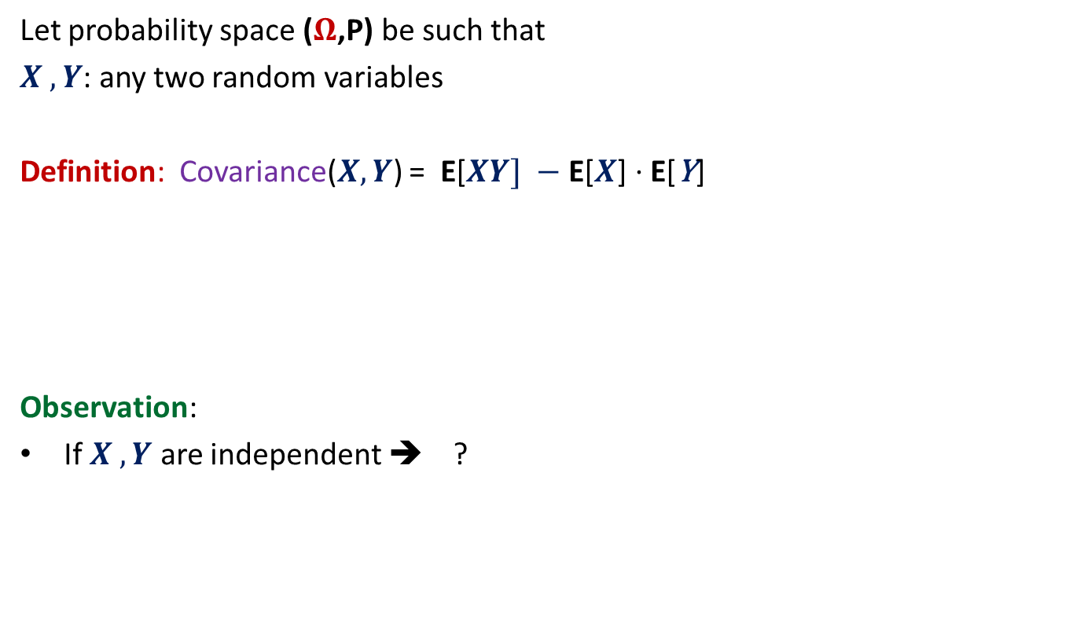
Covariance
Let probability space ($Ω$,P) be such that
$X ,Y$: any two random variables
Definition: Covariance($X,Y$) = $\text{E}\text{[}XY] −\text{E}\text{[}X\text{]}⋅\text{E}\text{[}\text{Y}\text{]}$
Observation:
If $X ,Y$ are independent ➔ ?
Covariance($X,Y$) = 0

Slide 7


Covariance
Let probability space ($Ω$,P) be such that
$X ,Y$: any two random variables
Definition: Covariance($X,Y$) = $\text{E}\text{[}XY] −\text{E}\text{[}X\text{]}⋅\text{E}\text{[}\text{Y}\text{]}$
Exercise 1: (Ball bin problem)
Let $X_{i}$ be the random variable defined as follows.
$X_{i}= \left\{\begin{aligned}1 if i th bin is empty \\ 0 otherwise \end{aligned}\right.$
Prove that Covariance($X_{i},X_{j}$) < 0 with least/no calculations.
$$(P\left[X_{i}=1\right|X_{j}=1 ] −P[X_{i}=1])⋅P[X_{j}=1]$$

Slide 8
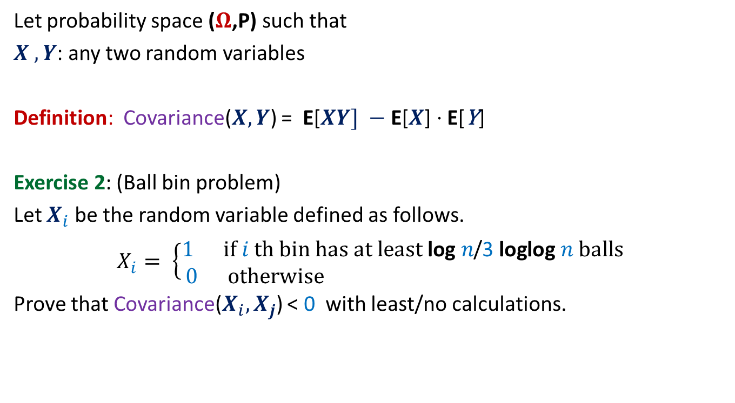
Covariance
Let probability space ($Ω$,P) such that
$X ,Y$: any two random variables
Definition: Covariance($X,Y$) = $\text{E}\text{[}XY] −\text{E}\text{[}X\text{]}⋅\text{E}\text{[}\text{Y}\text{]}$
Exercise 2: (Ball bin problem)
Let $X_{i}$ be the random variable defined as follows.
$X_{i}= \left\{\begin{aligned}1 if i th bin has at least \text{log} n\text{/}\text{3} \text{loglog} n balls \\ 0 otherwise \end{aligned}\right.$
Prove that Covariance($X_{i},X_{j}$) < 0 with least/no calculations.

Slide 9


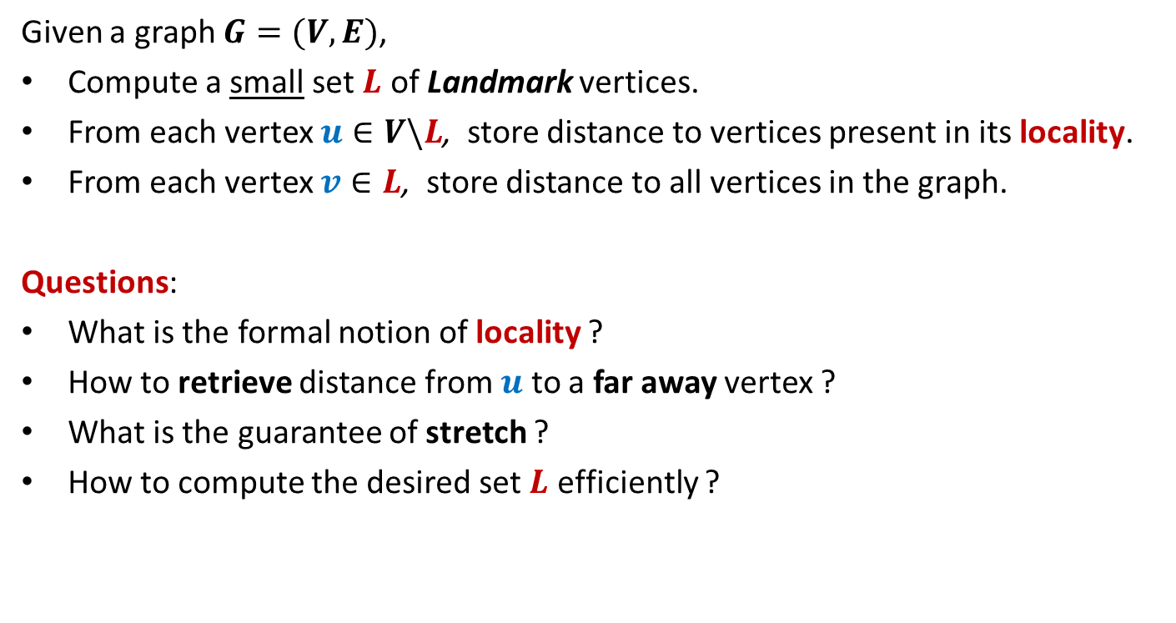
Var$(X+Y)$ = ?
Lemma: Var$(X+Y)$ = Var$(X)$ $+$ Var$(Y)$ $+$2 Cov$(X,Y)$
Proof: (homework)
using
linearity of expectation
definition of covariance.
If $X=\sum_{i}{X_{i}}$, then
Var$(X)$ = ?
$$\sum_{i}{\text{Var}\text{(}X_{i})}\text{+}\sum_{i≠j }{\text{Cov}\text{(}X_{i},X_{j}\text{)}}$$

Slide 10

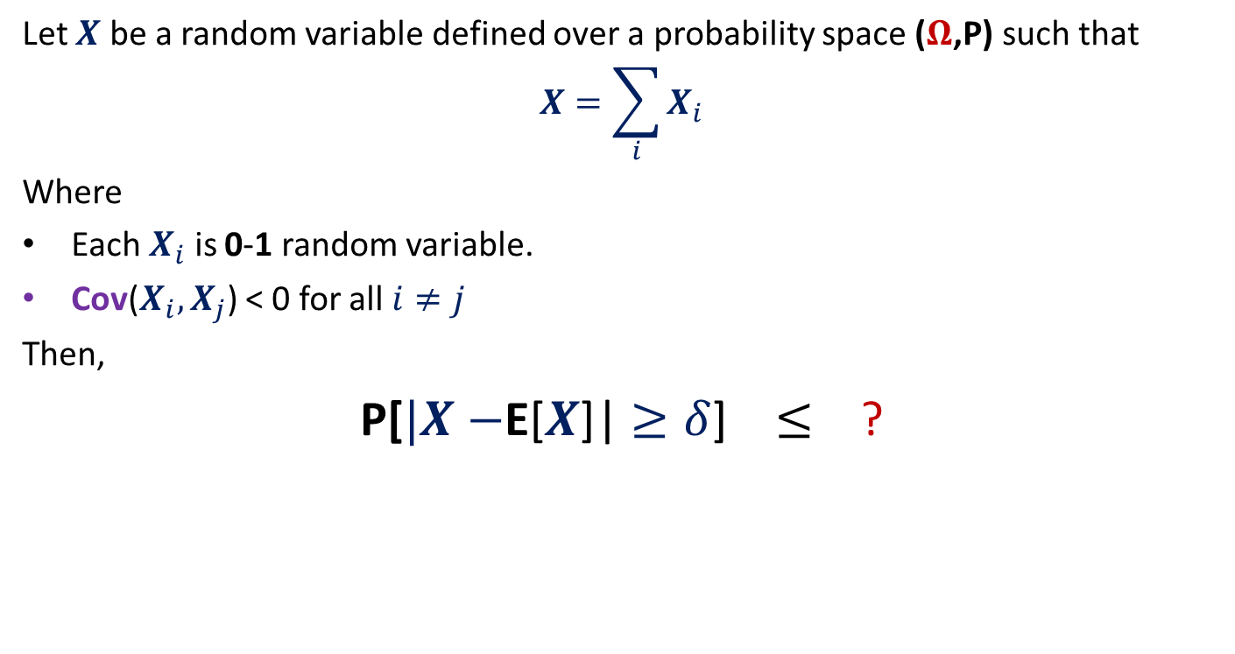
Theorem
Let $X$ be a random variable defined over a probability space ($Ω$,P) such that
$$X=\sum_{i}{X_{i}}$$
Where
Each $X_{i}$ is 0-1 random variable.
Cov($X_{i},X_{j}$) < 0 for all $i≠j$
Then,
P[$|X−$E[$X$]| $≥δ$] $≤$ ?
$$\frac{\text{E}\text{[}X\text{]}}{δ^{2}}$$

Slide 11

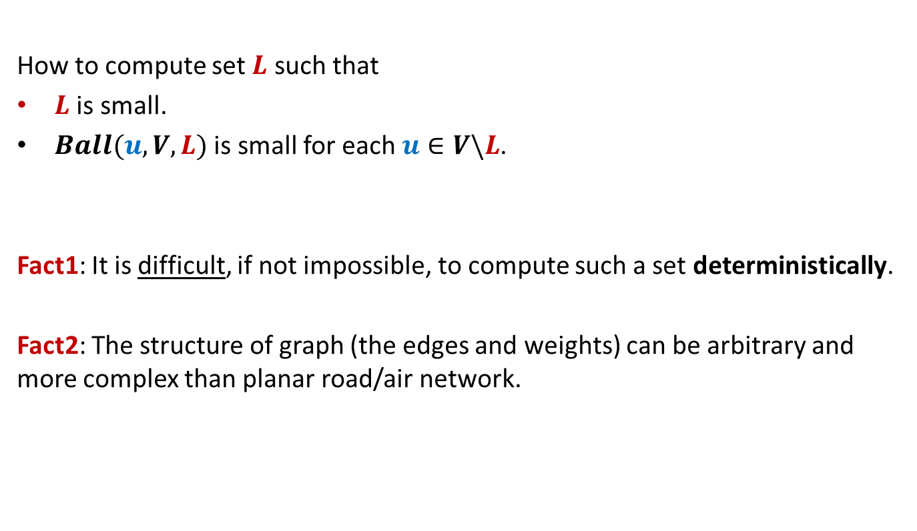

Proof of the theorem
P[$|X−$E[$X$]| $≥δ$]
$≤$ $\frac{\text{Var}\text{(}X\text{)} }{δ^{2}}$
$=\frac{\sum_{i}{\text{Var}\text{(}X_{i}\text{)}\text{+}\sum_{i≠j }{\text{Cov}\text{(}X_{i},X_{j}\text{)}}}}{δ^{2}}$
$≤\frac{\sum_{i}{\text{Var}\text{(}X_{i}\text{)}}}{δ^{2}}$
$≤\frac{\sum_{i}{\text{E}\text{[}X_{i}\text{]}}}{δ^{2}}$
$=\frac{\text{E}\text{[}X\text{]}}{δ^{2}}$
Using Chebyshev’s Inequality
Since$\text{Cov}\text{(}X_{i},X_{j})$ < $0$
Since$X_{i}$ is $0−1$ r.v.

Slide 12
Applications of the Theorm
Balls into Bins

Slide 13

Balls into Bins
1 2 3 4 5 … m-1 m
Ball-bin Experiment: There are $m$ balls and $n$ bins.
Each ball selects its bin randomly uniformly and independent of other balls.
1 2 3 … j … n

Slide 14
Application 1 of the Theorem
Balls into Bins: Empty bins

Slide 15

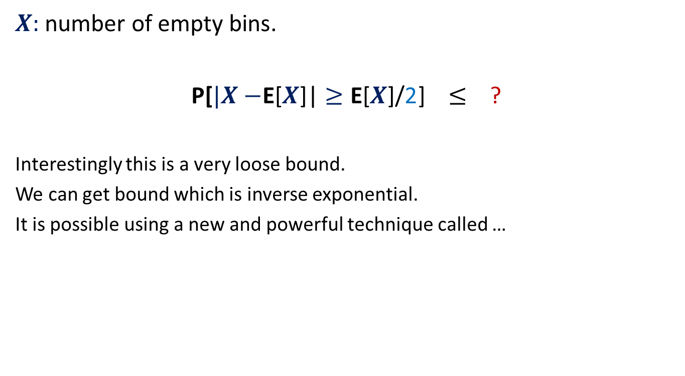

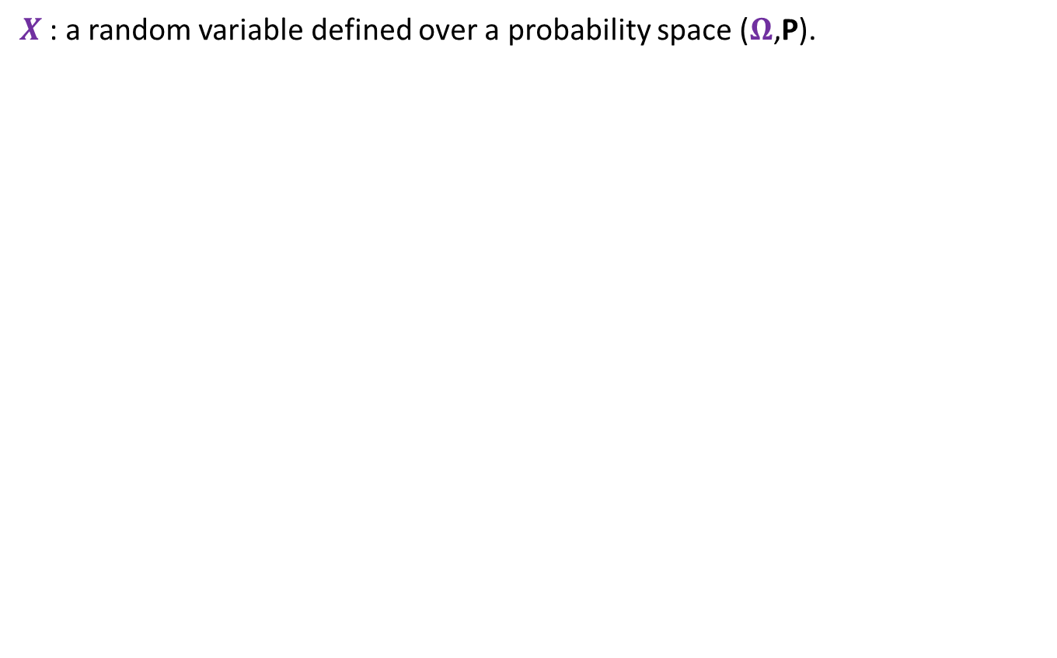
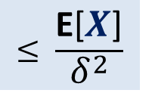
$X:$ number of empty bins.
P[$|X−$E[$X$]| $≥\text{E}\text{[}X\text{]}\text{/}\text{2}$] $≤$ ?
Interestingly this is a very loose bound.
We can get bound which is inverse exponential.
It is possible using a new and powerful technique called …
$$\frac{4}{\text{E}\text{[}X\text{]}}$$
exp($−c \text{E}\text{[}X$])
Theorem
P[$|X−$E[$X$]| $≥δ$]
$$≤ \frac{\text{E}\text{[}X\text{]}}{δ^{2}}$$

Slide 16

$X:$ number of empty bins.
P[$|X−$E[$X$]| $≥\text{E}\text{[}X\text{]}\text{/}\text{2}$] $≤$ ?
$$\frac{4}{\text{E}\text{[}X\text{]}}$$
exp($−c \text{E}\text{[}X$])
Theorem
P[$|X−$E[$X$]| $≥δ$]
$$≤ \frac{\text{E}\text{[}X\text{]}}{δ^{2}}$$

Slide 17
Method of bounded difference
This is the most powerful method. It also subsumes Chernoff Bound. We shall discuss it in the first class after the mid semester exam.

Slide 18
Method of bounded difference

Slide 19
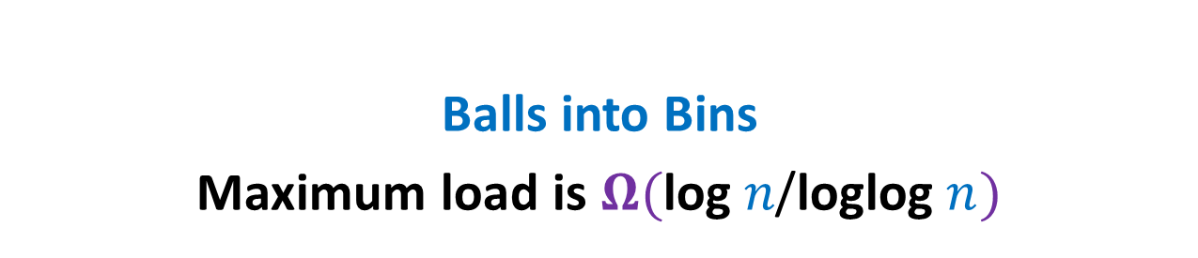
Application 2 of the Theorem
Balls into Bins
Maximum load is $Ω(\text{log} n\text{/}\text{loglog} n)$

Slide 20



Maximum load is $Ω(\text{log} n\text{/}\text{loglog} n)$
P(bin $j$ has at least $k$ balls)
≥ P(bin $j$ has exactly $k$ balls)
=$\left(\begin{matrix}n \\ k\end{matrix}\right)∙{{(\frac{1}{n} )}^{k} ∙(1−\frac{1}{n} )}^{n−k}$
≥ ${(\frac{n}{k} )}^{k}{{∙(\frac{1}{n} )}^{k} ∙(1−\frac{1}{n} )}^{n}$
≥ ${\frac{1}{4}∙(\frac{1}{k} )}^{k}$
For $k$ = ? , the value of ${(\frac{1}{k} )}^{k}≥n^{−1/4}$
$$\frac{\log{n}}{4 loglog n}$$

Slide 21




How to use Theorem ?
$X$: the number of bins with at least $\text{log} n\text{/}\text{4} \text{loglog} n balls$
P[$X=0$] = “There is no bin with $\text{log} n\text{/}\text{4} \text{loglog} n or more balls$”
Let $X_{j}$ be the random variable defined as follows.
$$X_{j}= \left\{\begin{aligned}1 if j th bin has at least \text{log} n\text{/}\text{4} \text{loglog} n balls \\ 0 otherwise \end{aligned}\right.$$
P[$X_{j}=1$] $≥n^{−1/4}$
E[$X$] $≥n^{3/4}$
P[$X=0$]
= P[$X−\text{E}\text{[}X\text{]}=−\text{E}\text{[}X\text{]}$]
$≤$P[$|X−\text{E}\text{[}X\text{]}\text{|}=\text{E}\text{[}X\text{]}$]
$≤$ P[$|X−\text{E}\text{[}X\text{]}\text{|}≥\text{E}\text{[}X\text{]}$]
$≤$ $\frac{1}{\text{E}\text{[}X\text{]}}$
Theorem
$$≤ \frac{\text{E}\text{[}X\text{]}}{δ^{2}}$$
P[$|X−$E[$X$]| $≥δ$]
$$≤n^{−3/4}$$

Slide 22
Random walk and Electric Network
A glimpse of a magical connection
https://math.dartmouth.edu/~doyle/docs/walks/walks.pdf

Slide 23
Random walk and Electric Networks
Doyle and Snell
https://math.dartmouth.edu/~doyle/docs/walks/walks.pdf

Slide 24




Random walk on a line
½
½
Question:
Suppose the random walk starts at $i$.
The walk terminates as soon as drunkard reaches home or bar.
What is the probability that the drunkard reaches home before reaching bar ?
Let $p(i)$ be the corresponding probability.
$p\left(0\right)=$ ?
$p\left(n\right)=$ ?
$p\left(i\right)=$ ?
bar
home
$$0$$
$$1$$
$$i−1$$
$$i$$
$$i+1$$
$$n−1$$
$$n$$
$$0$$
$$1$$
$$\frac{1}{2}p\left(i−1\right) + \frac{1}{2}p\left(i+1\right)$$

Slide 25


Random walk on a line
$V\left(i\right)$: Potential at point $i$.
$V\left(0\right)=0$, $V\left(n\right)=1$,
Current entering $i$ = Current leaving $i$.
$\frac{\left(V\left(i+1\right)−V\left(i\right)\right)}{1}$ = $\frac{\left(V\left(i\right)−V\left(i−1\right)\right)}{1}$
$V\left(i\right)=$ $\frac{1}{2}\left(V\left(i−1\right) + V\left(i+1\right)\right)$
current
$$0$$
$$1$$
$$i−1$$
$$i$$
$$i+1$$
$$n−1$$
$$n$$
$1$ Volt
Each resistance is 1 ohm.

Slide 26
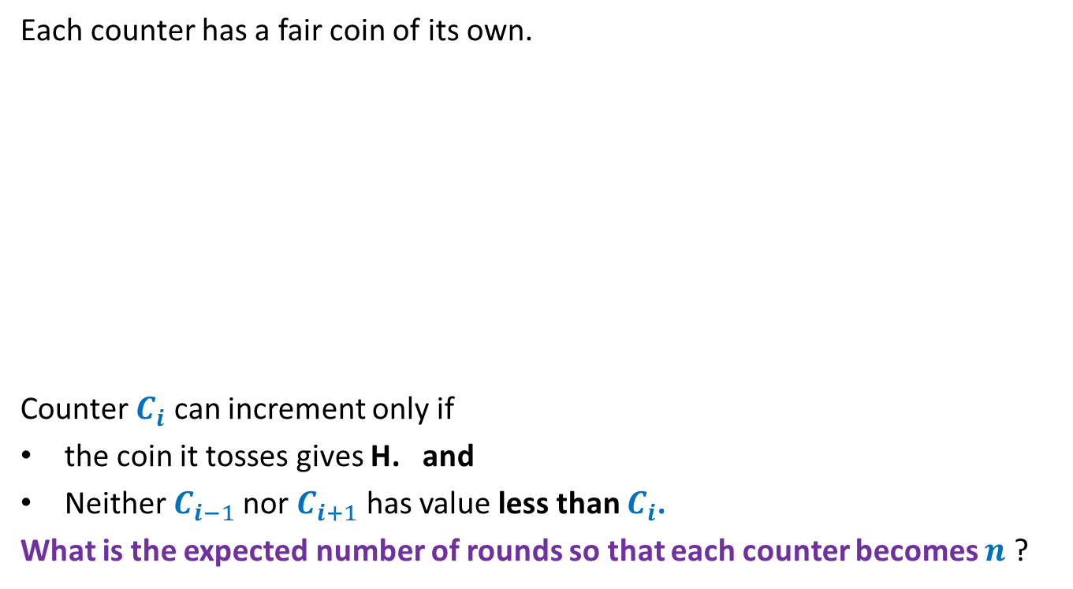
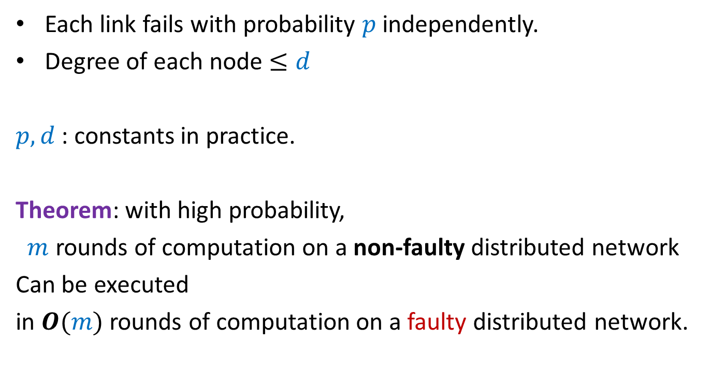


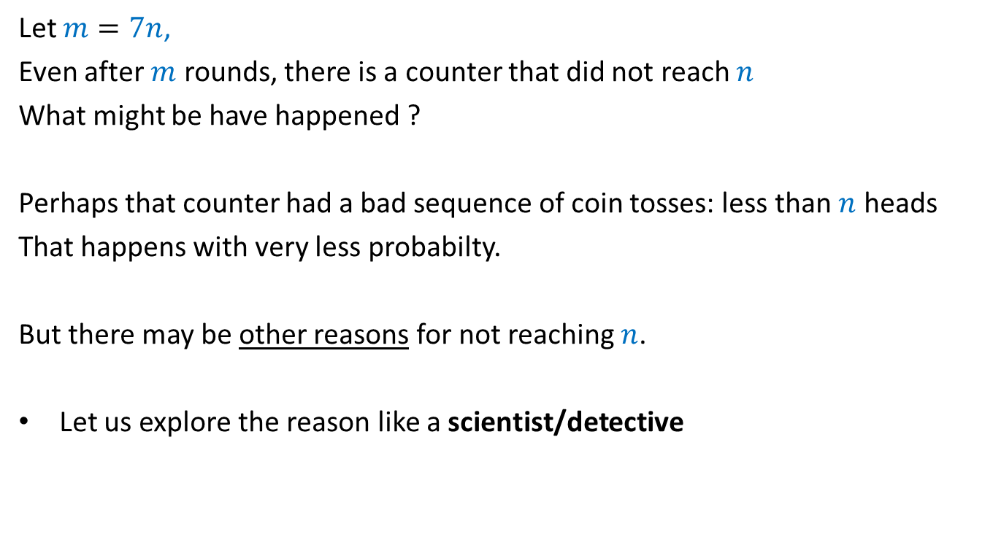
Random walk on a line
½
½
$p\left(0\right)=0$, $p\left(n\right)=1$, $p\left(i\right)=$ $\frac{1}{2}\left(p\left(i−1\right) + p\left(i+1\right)\right)$
$V\left(i\right)$: Potential at point $i$
$V\left(0\right)=0$, $V\left(n\right)=1$, $V\left(i\right)=$ $\frac{1}{2}\left(V\left(i−1\right) + V\left(i+1\right)\right)$
Hence $V\left(i\right)$ and $p\left(i\right)$ satisfy the same set of equations.
➔ If these equations have unique solution, then $V\left(i\right)=p\left(i\right)$ for all $i$.
bar
home
$$0$$
$$1$$
$$i−1$$
$$i$$
$$i+1$$
$$n−1$$
$$n$$
current
$$0$$
$$1$$
$$i−1$$
$$i$$
$$i+1$$
$$n−1$$
$$n$$
$1$ Volt

Slide 27


Harmonic function in 1-dimension
Definition: function $f$ defined on [$0,n$] is said to be harmonic function if
at each internal point $i$
Lemma: A harmonic function attains its maximum (and minimum) value at
the boundary points.
$f$($i$) = $\frac{1}{2}\left(f\text{(}i−1\text{)}\text{ +}f\text{(}i+1\text{)}\right)$
$$0$$
$$1$$
$$i−1$$
$$i$$
$$i+1$$
$$n−1$$
$$n$$
Boundary point
Boundary point
Internal points

Slide 28
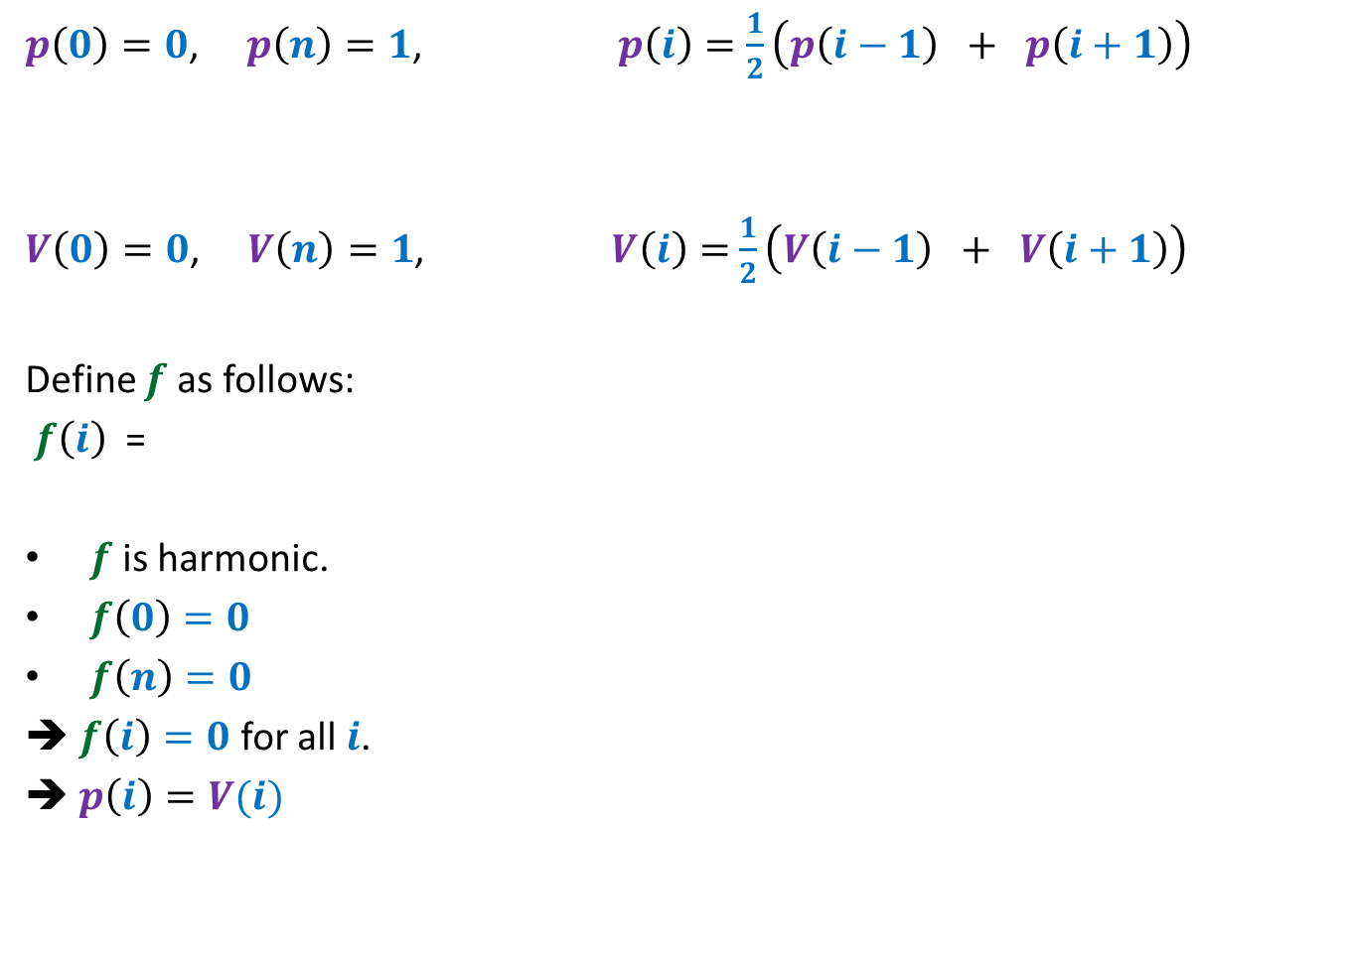
Random walk on a line
$p\left(0\right)=0$, $p\left(n\right)=1$, $p\left(i\right)=$ $\frac{1}{2}\left(p\left(i−1\right) + p\left(i+1\right)\right)$
$V\left(0\right)=0$, $V\left(n\right)=1$, $V\left(i\right)=$ $\frac{1}{2}\left(V\left(i−1\right) + V\left(i+1\right)\right)$
Define $f$ as follows:
$f\left(i\right)$ =
$f$ is harmonic.
$f\left(0\right)=0$
$f\left(n\right)=0$
➔ $f\left(i\right)=0$ for all $i$.
➔ $p\left(i\right)=V(i)$
$$p\left(i\right)−V(i)$$

Slide 29








$$y$$
$$b$$
home
Question: What is $p_{x}$, probability of reaching home before bar ?
$p_{v}=0$,
$p_{c}=1$,
$p_{x}=\frac{1}{ deg(x) }\sum_{y∈N(x)}{p_{y}}$
$$c$$
bar
$$v$$
$$x$$
$$u$$
$$g$$
$$d$$
$$a$$
$$z$$

Slide 30

1 volt
$$y$$
$$b$$
Question: What is relation between $V_{x}$ and $V_{y}$’s where $y∈N(x)$ ?
$V_{v}=0$,
$V_{c}=1$,
Net current leaving $x$is 0.
$\sum_{y∈N(x)}{{(V}_{x}−V_{y}) \text{=0}}$
➔ $V_{x}=\frac{1}{ deg(x) }\sum_{y∈N(x)}{V_{y}}$
$$c$$
$$v$$
$$x$$
$$u$$
$$g$$
$$d$$
$$a$$
$$z$$

Slide 31


$$y$$
$$b$$
Question: What is relation between $V_{x}$ and $V_{y}$’s where $y∈N(x)$ ?
$V_{v}=0$,
$V_{c}=1$,
$$V_{x}=\frac{1}{ deg(x) }\sum_{y∈N(x)}{V_{y}}$$
Hence $V_{x}$ and $p_{x}$ satisfy the same set of equations.
➔ Since these equations have unique solution, therefore $V_{x}=p_{x}$ for all $x$.
$$c$$
$$v$$
$$x$$
$$u$$
$$g$$
$$d$$
$$a$$
$$z$$
$p_{v}=0$,
$p_{c}=1$,
$$p_{x}=\frac{1}{ deg(x) }\sum_{y∈N(x)}{p_{y}}$$

Slide 32
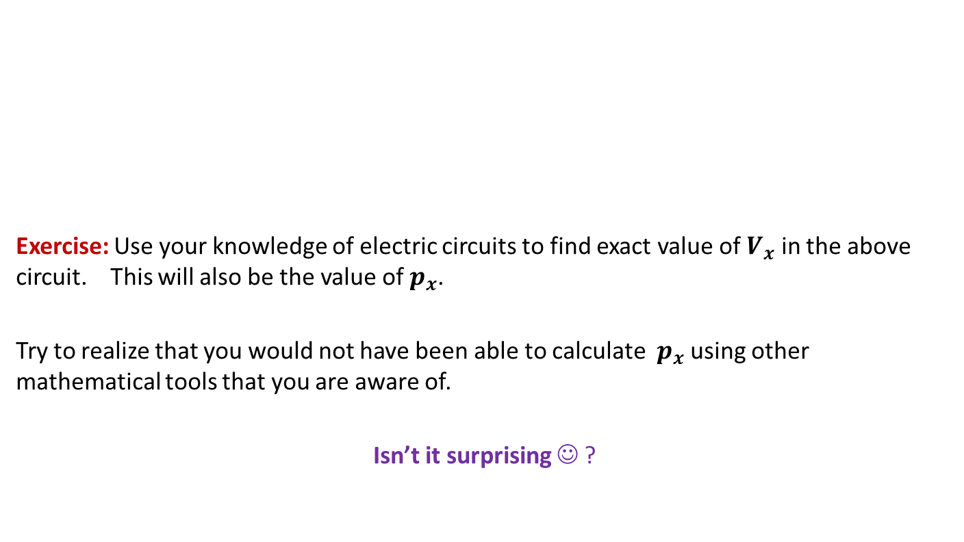
$$y$$
$$b$$
Exercise: Use your knowledge of electric circuits to find exact value of $V_{x}$ in the above circuit. This will also be the value of $p_{x}$.
Try to realize that you would not have been able to calculate $p_{x}$ using other mathematical tools that you are aware of.
Isn’t it surprising ☺ ?
$$c$$
$$v$$
$$x$$
$$u$$
$$g$$
$$d$$
$$a$$
$$z$$

